Slide 1
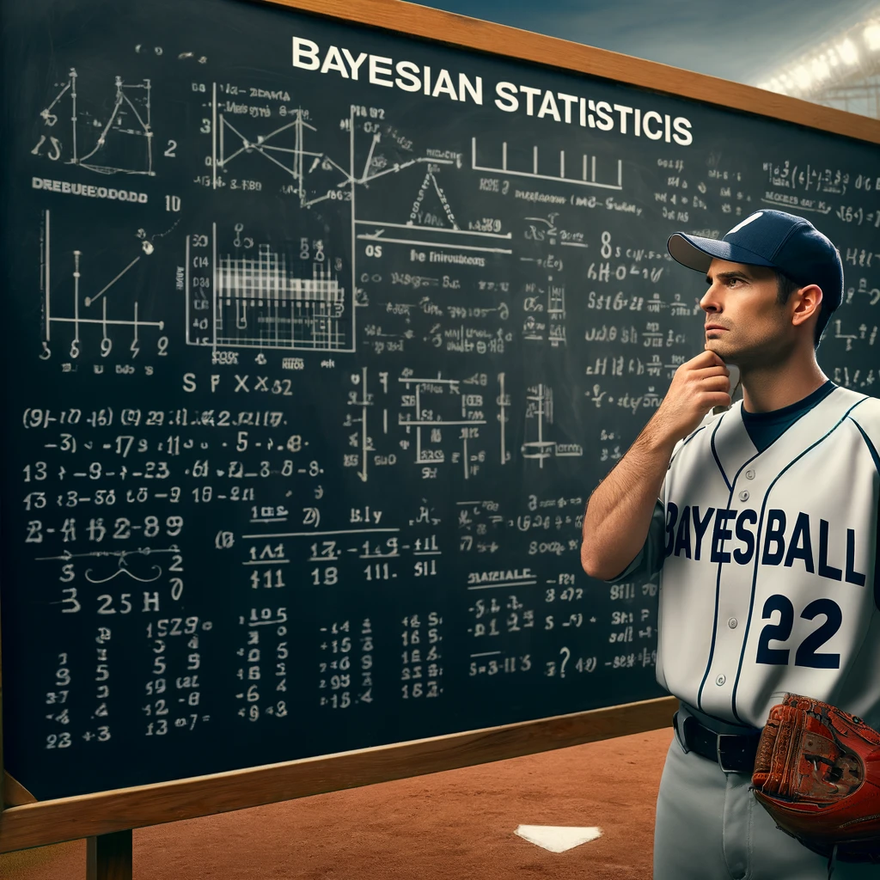
Bayesball
Steven Tsai | KIN482D
April 10 2024
Source: Chat GPT (only for this picture I promise)

Slide 2
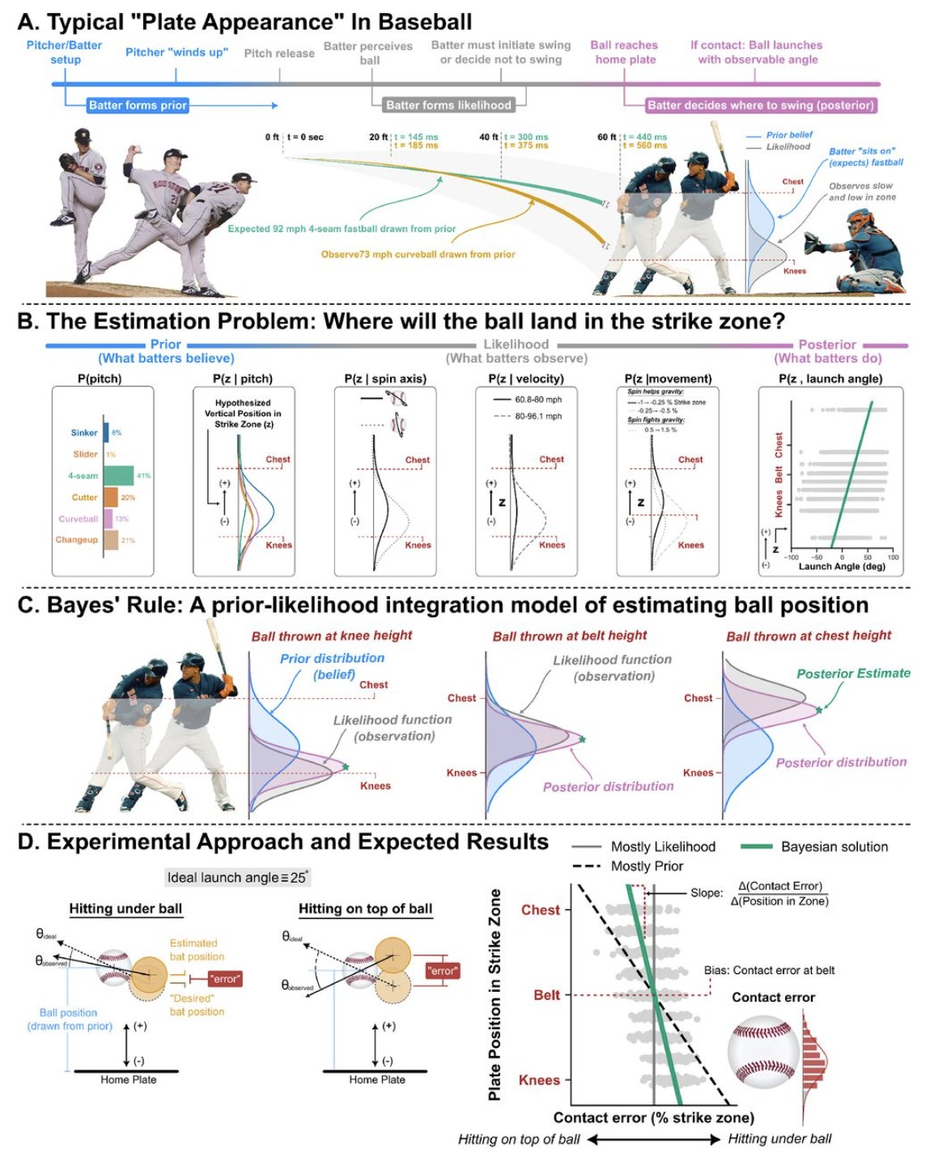
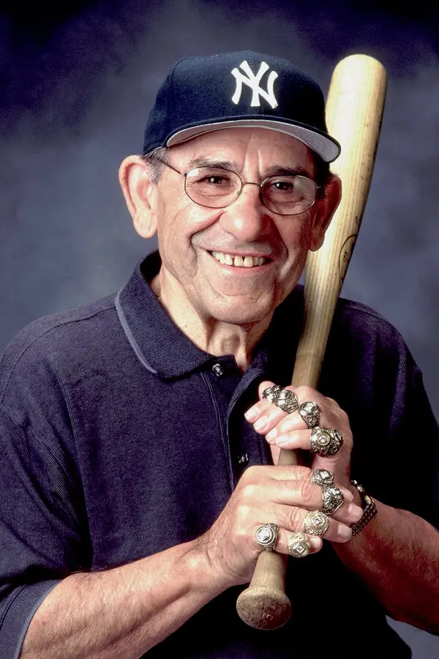
Brantley & Körding (2022)
“You can’t think and hit at the same time” — Yogi Berra
Would a batter be Bayesian?
Making decision with posterior that comes from integrating prior and likelihood

Slide 3
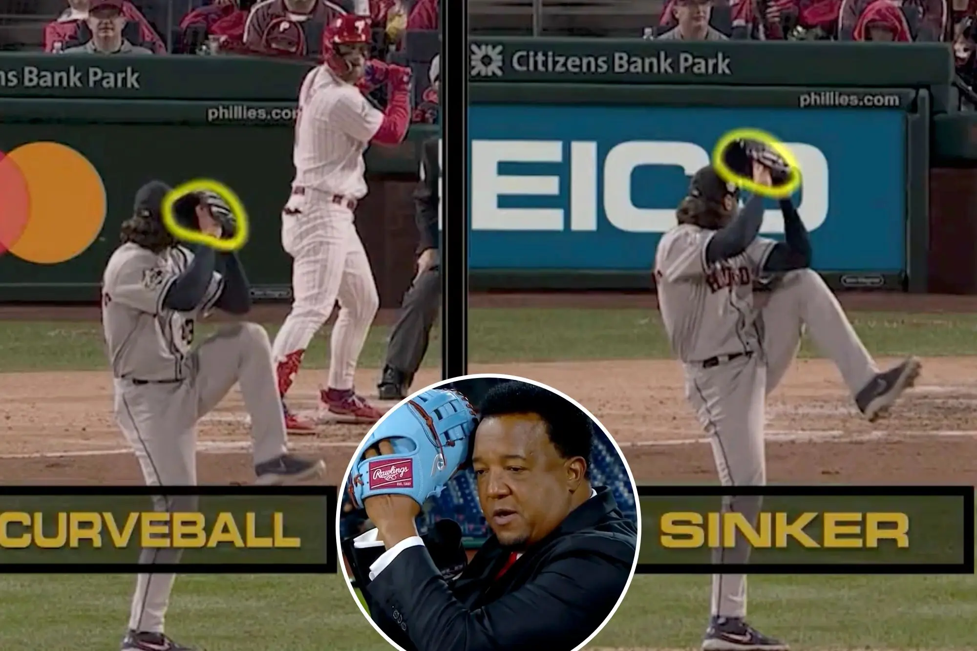
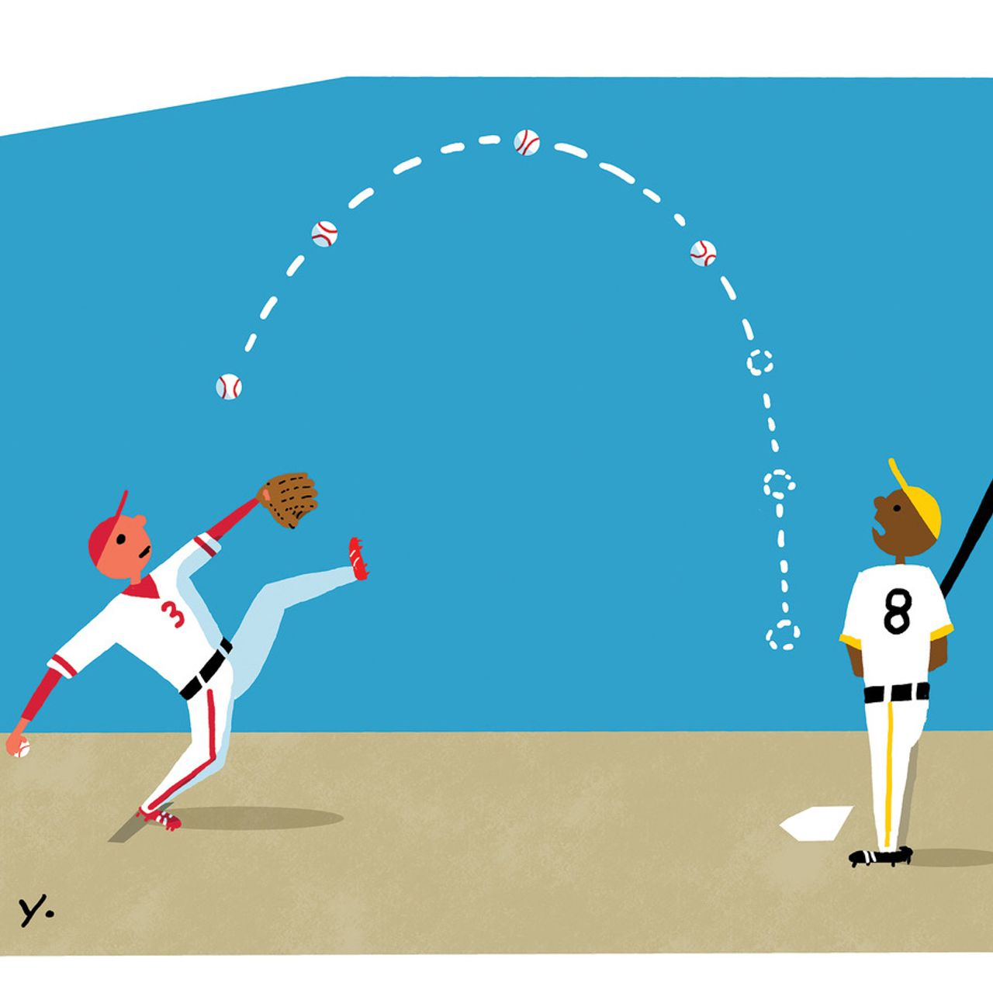
Three special cases
Pitch tipping
Narrower prior -> narrower posterior
Knuckleball
Wide prior, wide likelihood
Likelihood is still more informative than prior
Posterior relied on likelihood
Eephus
Wide prior, narrow likelihood -> narrow posterior

Slide 4
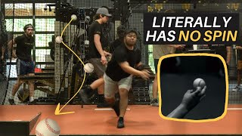
Knuckleball (source: Tread Athletics)

Slide 5
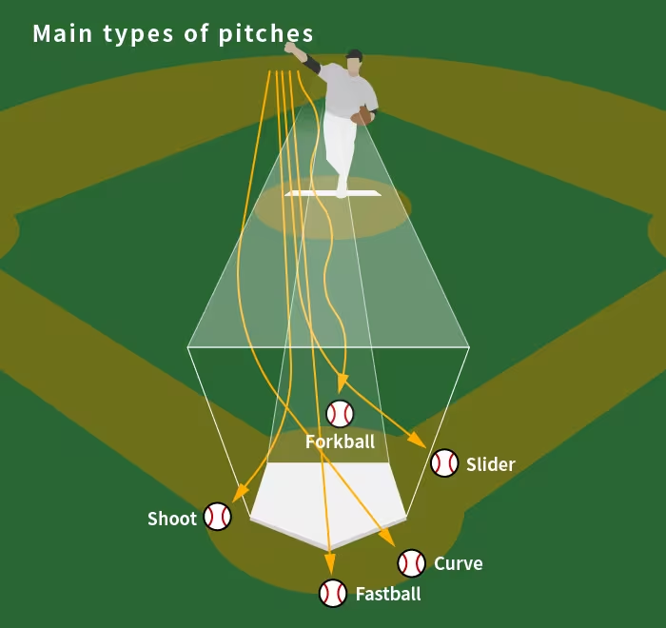
The issue
Motivation/Goals
Uncommon!
Only considering the vertical distance above the plate (z-axis)
Try to visualize the decision-making process on the strike zone plane (both x-axis and z-axis)
“What kind of pitch is coming?”
Uncertainty in the pitch type of the incoming pitch
Explore it using bayesian framework

Slide 6
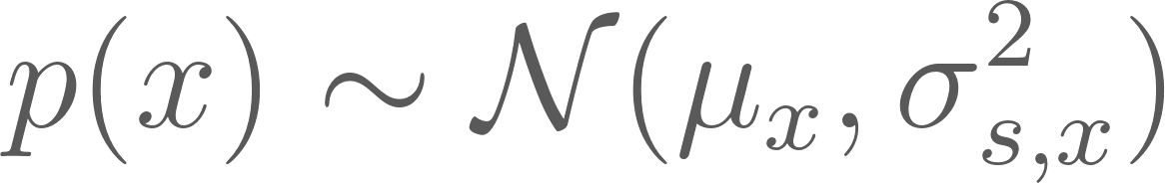
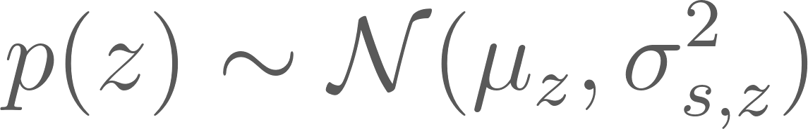
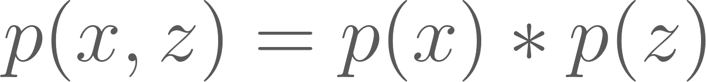
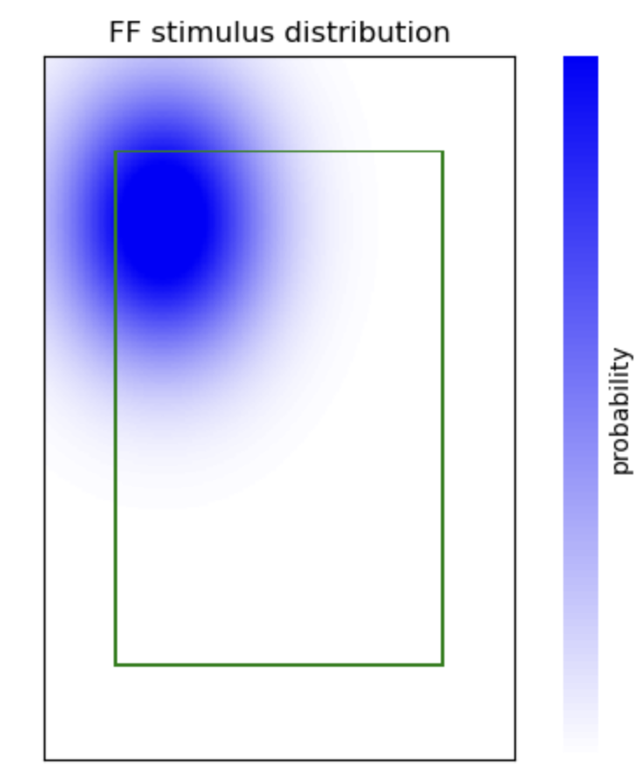
Case 1: only fastball
In-lab (batting cage) experiment
With technologies to track movements of the ball & the swing
A finely calibrated pitching machine
Gives us access to the stimulus distribution
Feed the stimulus distribution to the batter
Artificially create his prior
In reality, we won’t have access to the batter’s prior (Brantley & Körding, 2022)

Slide 7
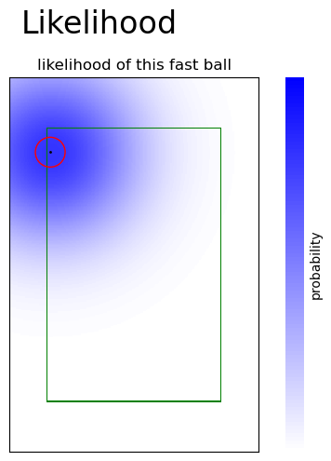
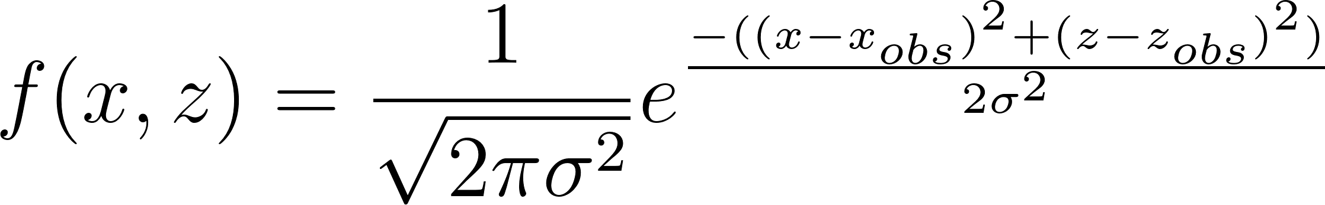
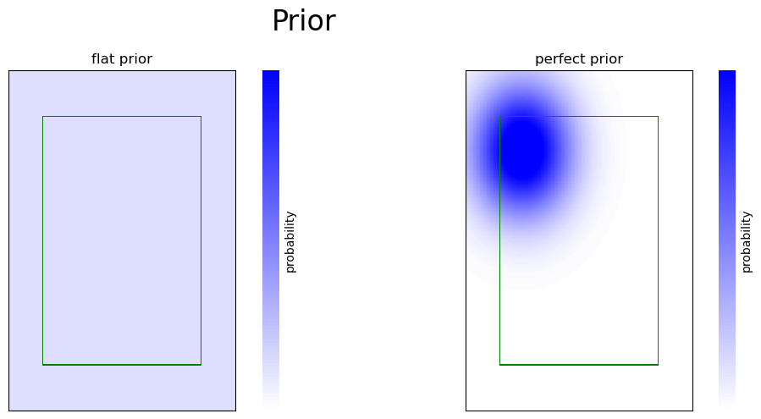
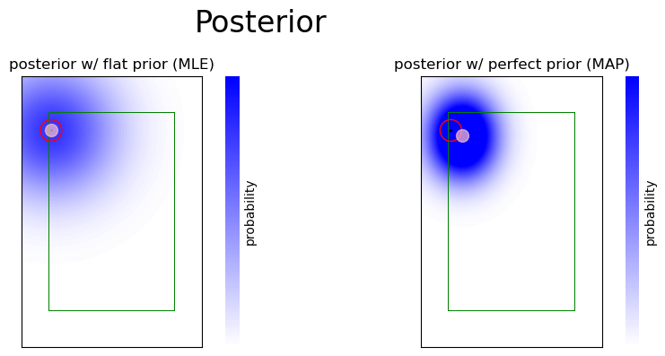
Case 1: result
—----------------------

Slide 8
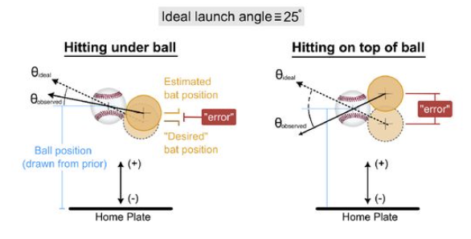
Case 1: find sigma (batter’s measurement param)
Assumptions:
Batter uses stimulus distribution as his prior
Batter aims to hit at 25deg (optimal launch angle for a homerun)
Contact error (Brantley & Körding, 2022)
Collect data -> Calculate the max log likelihood of sigma! (textbook C.5)
Concerns:
Motor noise!
Z-axis only?
Contact happens in a 3D space

Slide 9
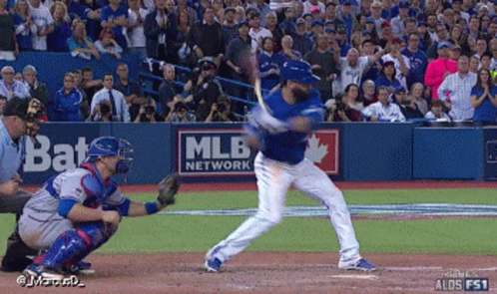
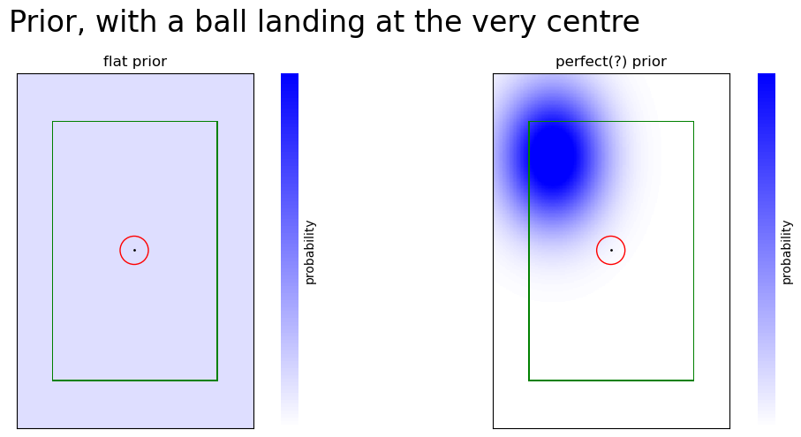

Case 1: surprise pitch
OR
?

Slide 10
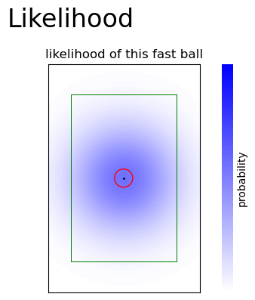
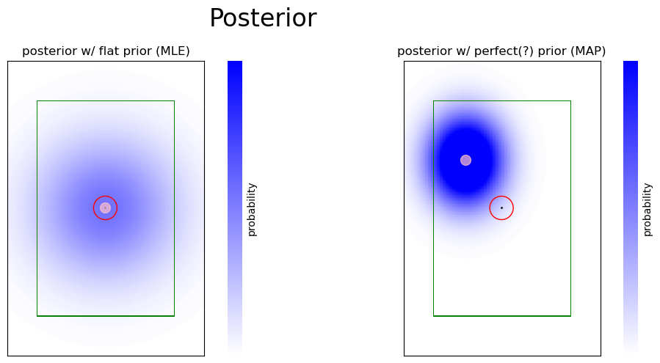
surprise pitch - result

Slide 11
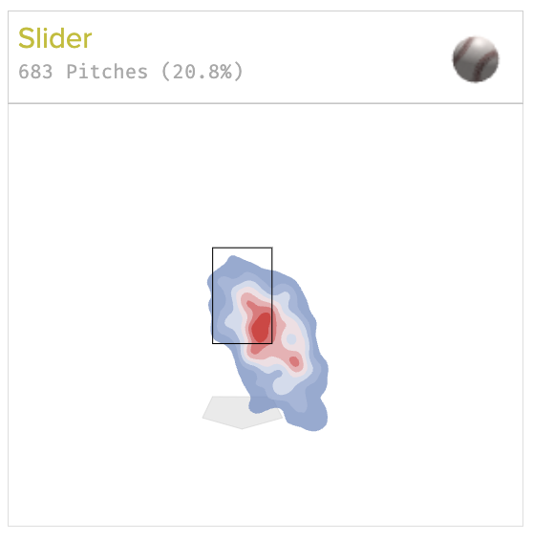
About Prior
Powerful when there is some level of measurement uncertainty
But can be misleading if incorrect
Actually, if only fastballs, an elite batter may have a lot narrower likelihood
Pulls the posterior closer to the observation even if it is a surprise pitch
Would be interesting to run in the lab
In reality, is not necessarily Gaussian
Can just be a probability matrix —>
Do the pointwise multiplication w/ likelihood
Happens in the batter’s brain - not measurable

Slide 12
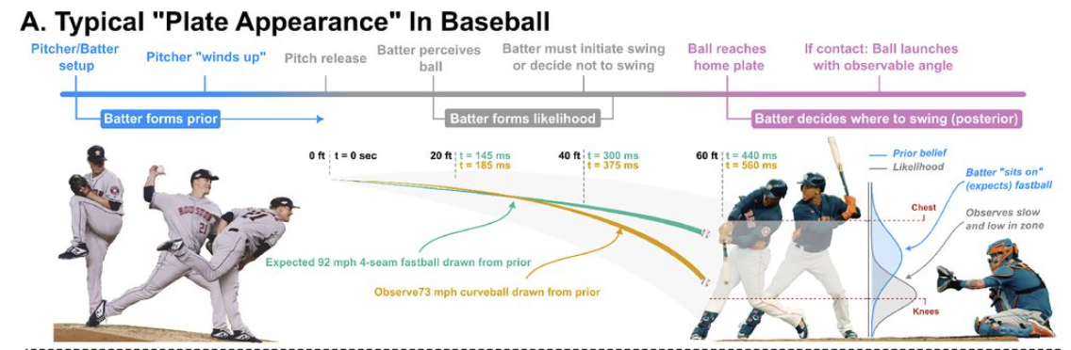
Timeline of a fastball (Brantley & Körding, 2022)

Slide 13
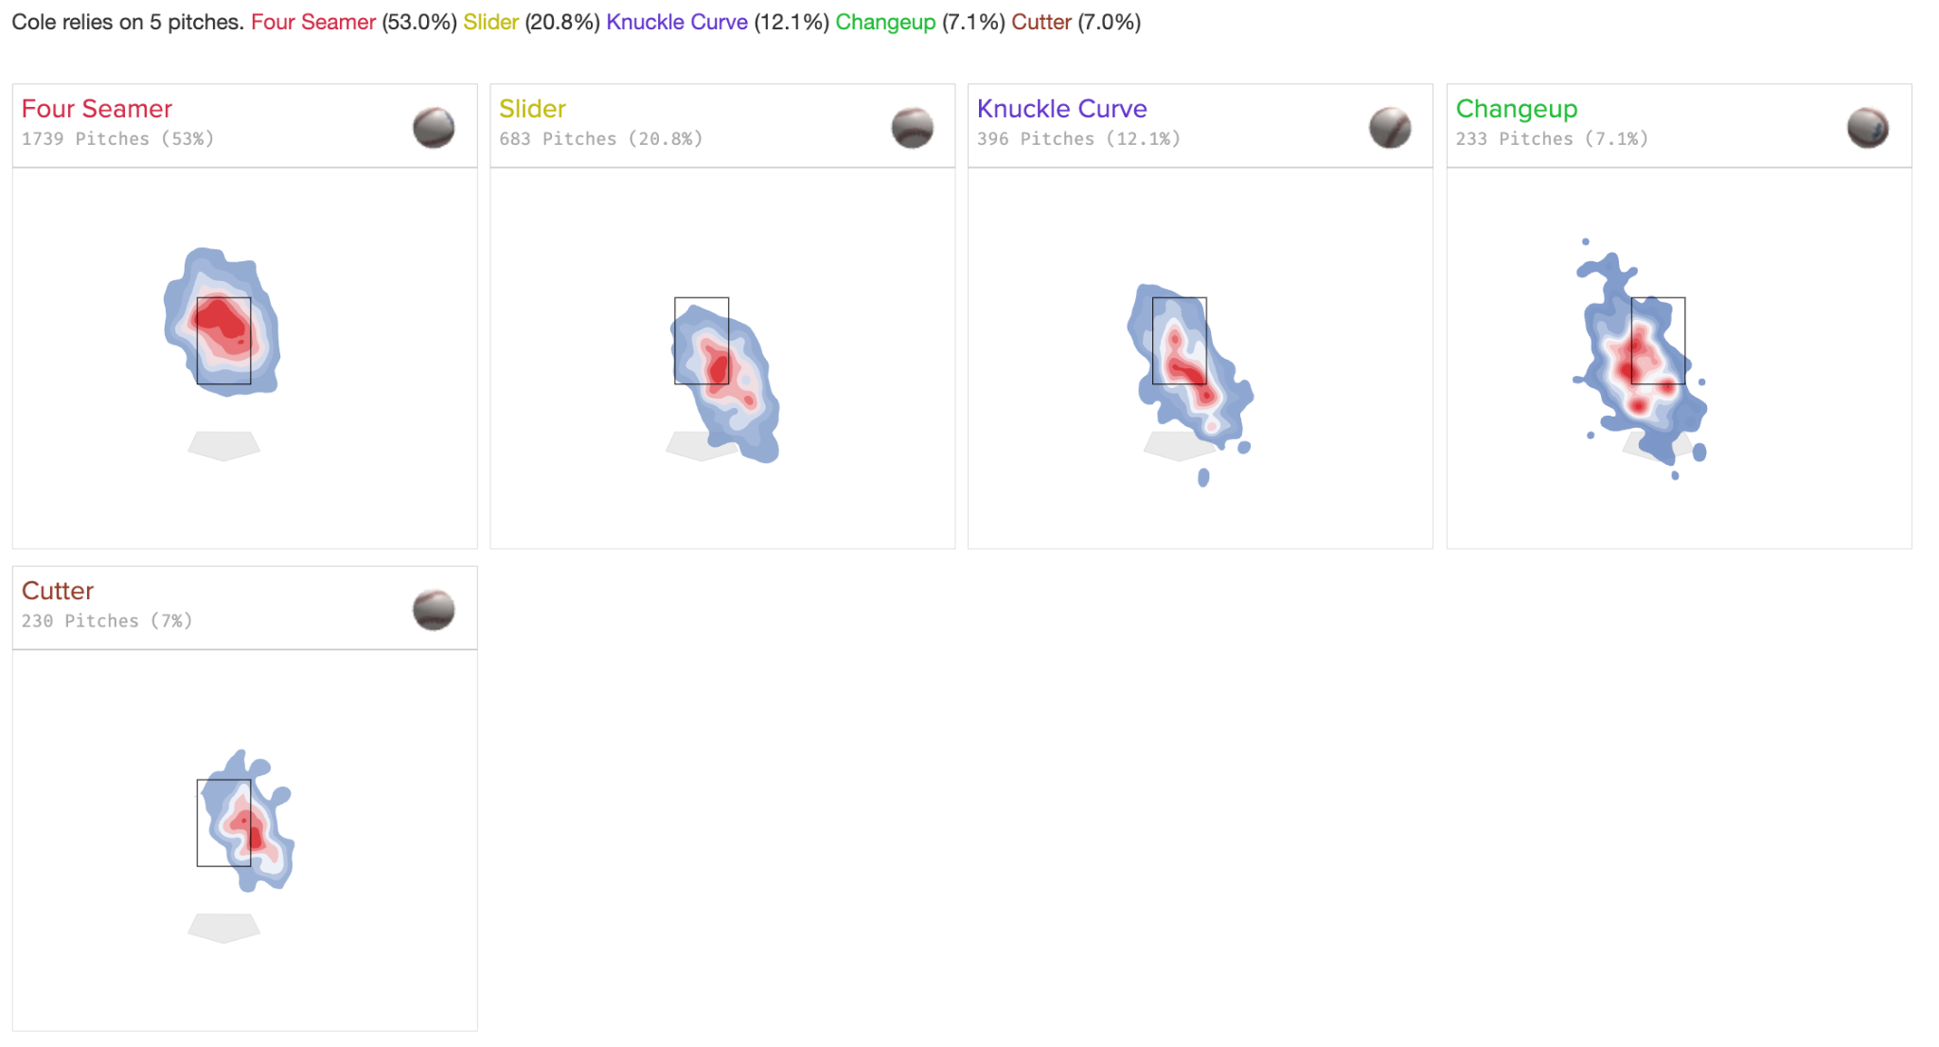
Case 2: uncertainty in pitch type

Slide 14
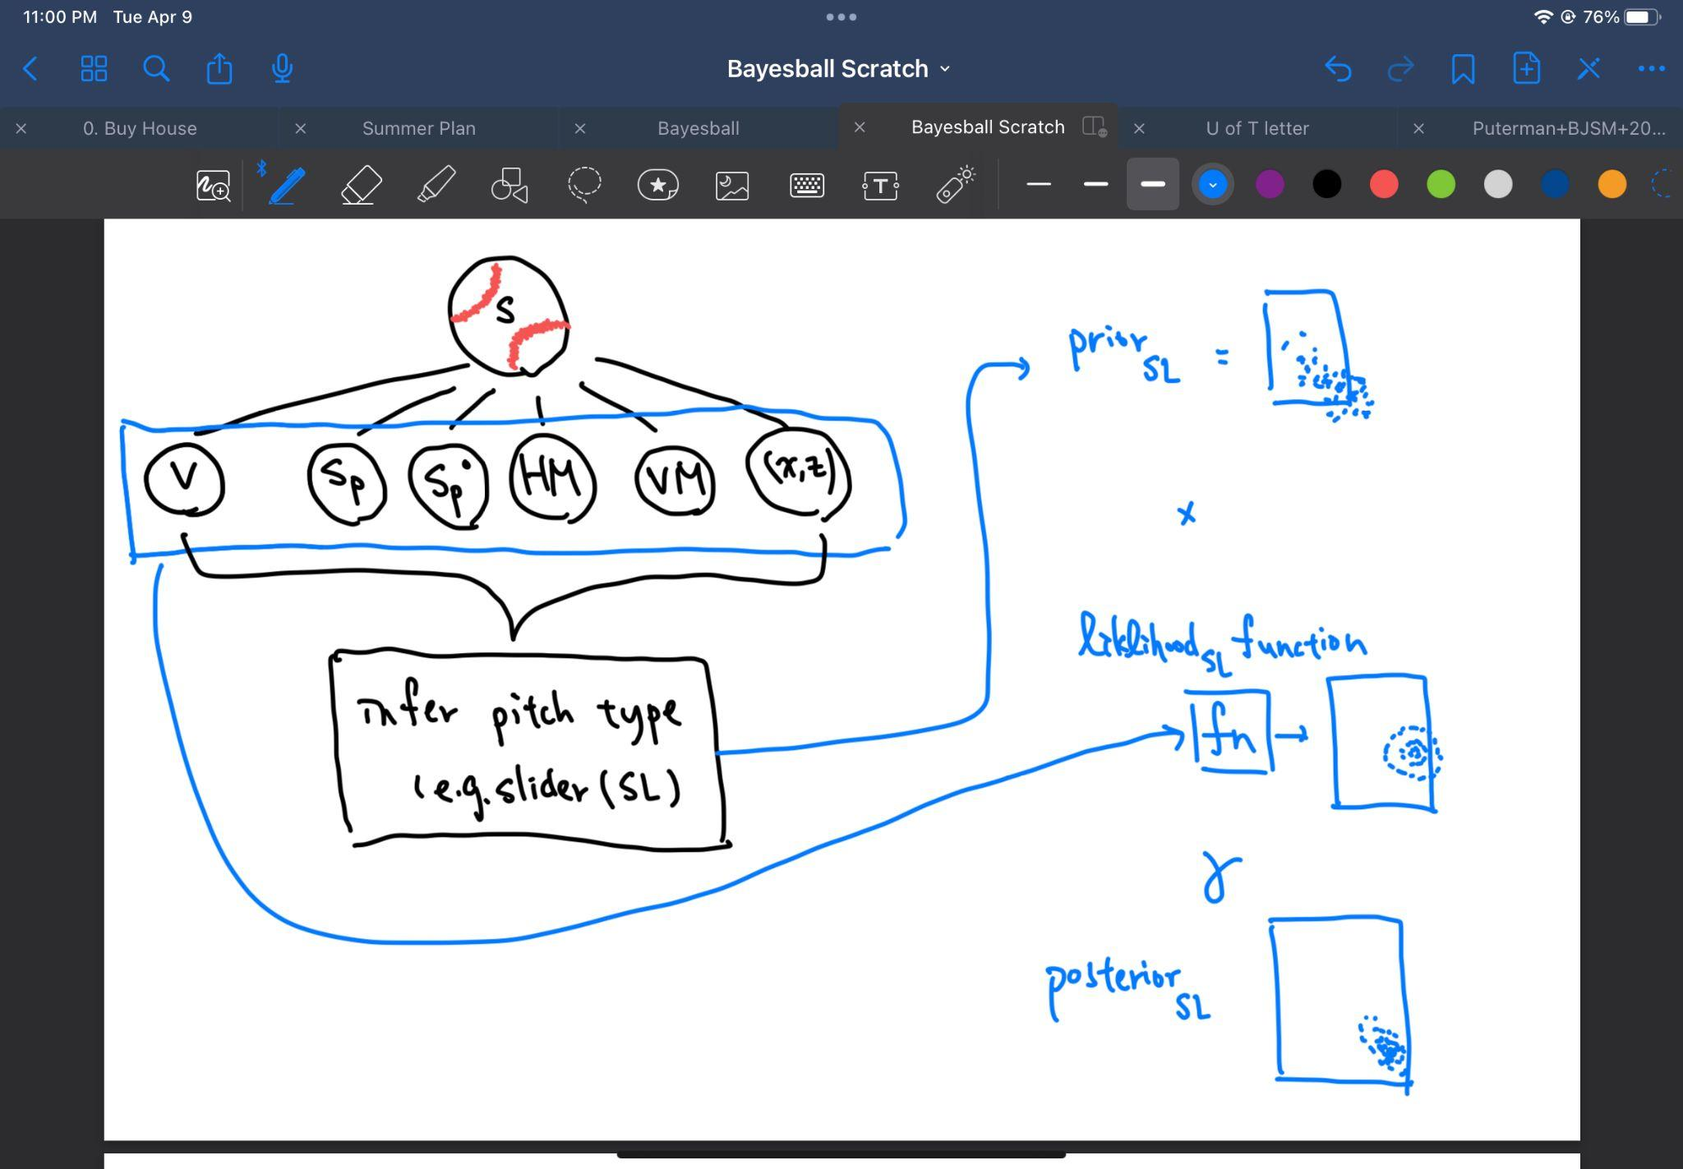
Case 2: Generative Model (tentative)
Step 1: infer pitch type
Prior: p(pitch)
Fastball (50%)
Slider (35%)
Changeup (15%)
Observation *from the 1st half of the trajectory:
V: speed
Sp: spin
Sp°: spin angle
HM: horizontal movement
VM: vertical movement
x,z: horizontal & vertical positions
Cue Combination:
Find the pitch type:

Slide 15
(some of the) Concerns/Future Directions
This model is confined to a 2D plane
Good: easy to visualize & understand
Bad:
Cannot consider swing timing
inference happens during the flight of the pitch; not on the strike zone plane
Contact not only happens on the strike zone plane; inaccurate when calculating response distribution/utility
A 3D model can be built if possible
Data gathering
Using technologies e.g. HitTrax, high speed camera, radar
When using launch angle to find the sigma (using max log likelihood)
Motor noise is not differentiated from it
How significant is the motor noise, given that swinging involves movement from multiple joints

